Slide 1
Machine Learning
This program tries to understand relation between features(age, salary, attrition and etc. ) in training data.
It Also predicts the attrition status of personnel and gives recommendations to cancel the attrition.
How to use this program?
In python just import the class and call it’s methods:
import knx_model
model = knx_model()
model.train(training_data)
result = model.predict(sample)
recommendations = model.recommend(sample)

Slide 2





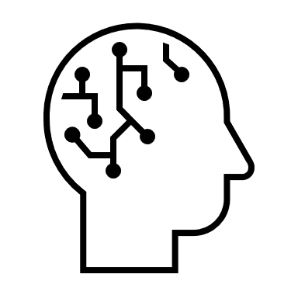






Only accessible to Superadmin
Start
Store the data in the DB
Display employee's attrition on the charts
Attrition details and recommendation
Log in
1. Scenario:
First time log in
Upload files to train the machine and analyse the attrition
AI/ML will analyze the data to predict the attrition
HR Admin is able to make notes/create remindeser
AI/ML will analyze the data to predict the attrition
Attrition details and recommendation
2. Scenario:
Default process
Log in
Store the data in the DB
Display employee's attrition on the charts
HR Admin is able to make notes/create remindeser
3. Scenario:
User management
Log in
Only accessible to Superadmin
Superadmin will be able to manage users and security roles
4. Scenario:
Notes/Reminders/
Tasks
Log in
Both HR Admin and Superadmin should be able to manage the notes/reminders/tasks
5. Scenario:
Editing own profile
Log in

Slide 3


data-sample (historical and current data
company‘s actual data (employee that didn‘t leave the company yet)
Predict the attrition of the employees and give recommendations to prevent the attrition
Train the machine

Slide 4
Machine Learning Workflow
Train phase:
Get data from DB => clean data => select best features => train model => save model in DB
Prediction phase:
Get prediction data => make prediction => give result
Recommendation phase:
Find similar personnel with No attrition => Analyze results => give results

